Slide 1

Decisions CS 110 - Introduction to Programming
Can you put the correct mathematical symbols into the spaces to make the sum accurate?
7 (__) 4 (__) 2 = 30
Brother W. Clements

Slide 2
Cans of Nothing
Thirty spokes share the wheel's hub;
It is the center hole that makes it useful.
Shape clay into a vessel;
It is the space within that makes it useful.
Cut doors and windows for a room;
It is the holes which make it useful.
Therefore profit comes from what is there;
Usefulness from what is not there
Chapter 11 of Tao T& Ching

Slide 3
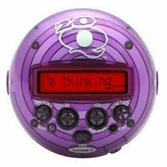
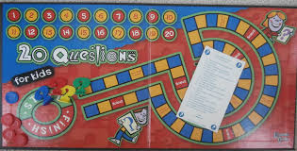
20 Question Game
Ask only yes or no questions
You have 20 guesses

Slide 4
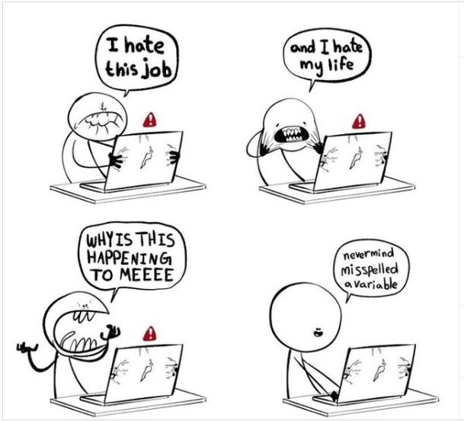
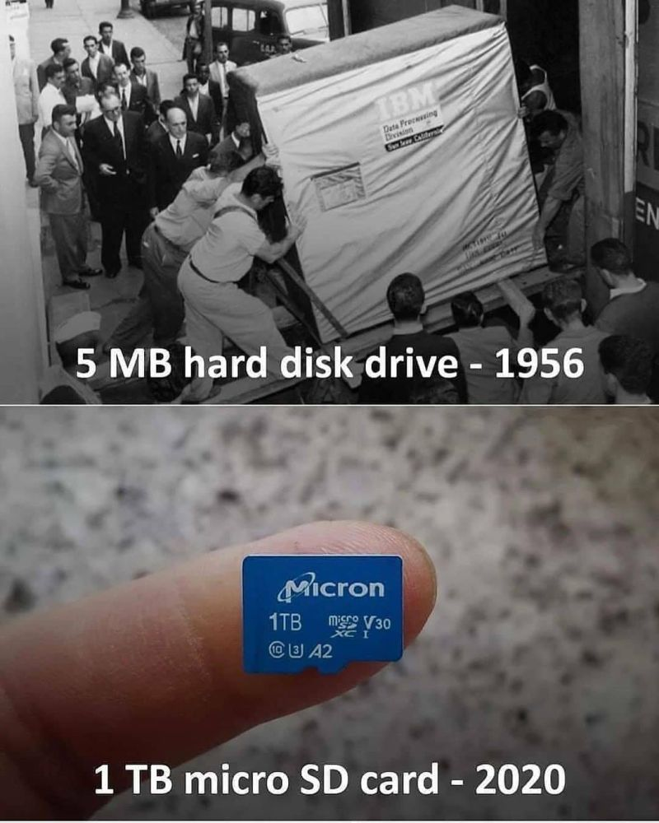
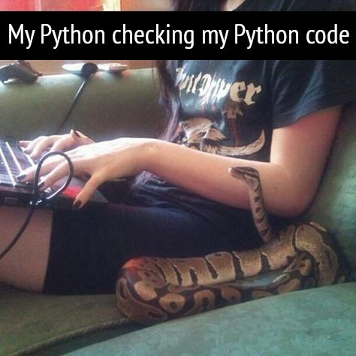

Slide 5
Review
Output
print (<string>)
print (“….{}”.format(<var>))
print (f”…{<var>})
Input
Var_string = input(<string>)
<Strings>
+
str(<var>)
Functions: .capitalize, .lower, .upper, .title, .count
Integers
+, operators (add, sub, mult, div, whole, remainer, exp
int(<var>)
Floats
+, operators (
float(<var>)
Libraries - import
Math: ceil, floor, exp, sin
Comments
In-line, block,
Variable Name
underscore
What do we know about?
Displaying things to the screen?
Getting input from the user?
Strings
Integers
Floats
Libraries
Comments
Variable Names

Slide 6
Program
Input
Process
Output
Str prompt
Magic
(equations)
(algorithms)
(etc)
⌨️
input(<str>
Patterns:
Var = var operator var
Var = var.function()
Str “”
=
Var
float( )
If(decimal)
Strings: +, .functions()
Numbers: math
int( )
If(whole)
Var
+
f”. {} “
:.#f
If(decimal)
str( )
str( )
“ {} “.format(var..)
If(whole)
If(str)
📺
VarStr = input(“prompt?”)
VarF = float(VarStr)
VarI = int(VarStr
Str “”
print(<str>)
“ “, \t, \n

Slide 7
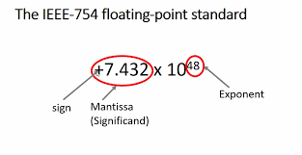
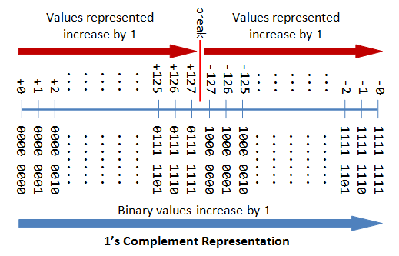
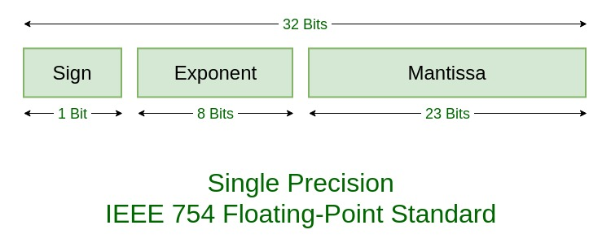
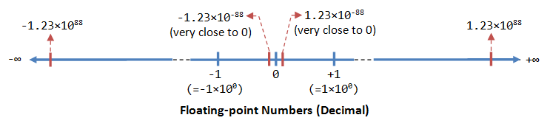
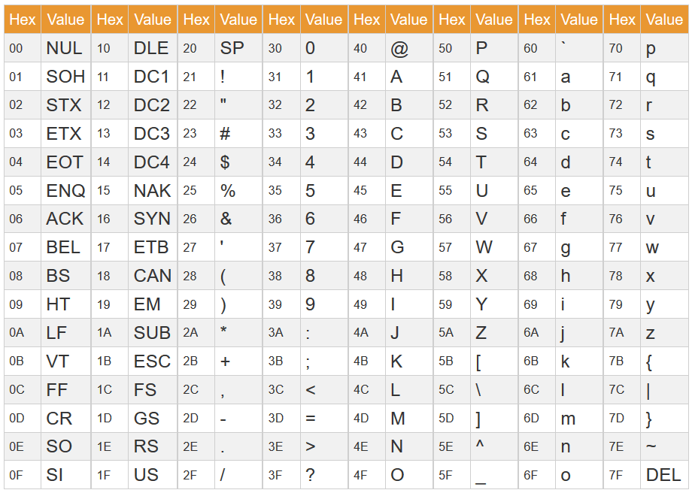
Testing
Is it true or not
Scientific Method - > T/F
Number Line
# <----.----0-----o---->
#. -3 4
-3 <= x AND x < 4, keep your variable in the middle
Floats (Precision problem: infinite→finite)
1/10 != .1
1/3 != .33
Strings
A != a
apple > applE ; subtraction of each letter.
https://www3.ntu.edu.sg/home/ehchua/programming/java/datarepresentation.html

Slide 8
New Type -Boolean
You know of three data types:
Strings “” a-Z
Floats .
Ints #
Boolean: Only has two values:
True (1)
False (0)
0 is false, everything else is true

Slide 9
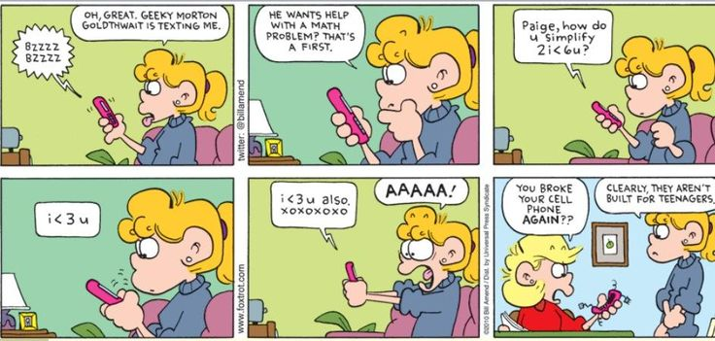
Inequalities
= (set equal) is not the same as
== (compare equal) True or False
<, <=, ==, !=, >=, > True or False
Ranges AND OR True or False

Slide 10
Program
Input
Magic
(equations)
(algorithms)
(etc)
Process
Output
Str prompt
Patterns:
Var = var operator var
Var = var.function()
⌨️
input(<str>
Str “”
=
Var
Strings: +, .functions()
Numbers: math
float( )
If(decimal)
int( )
If boolean:
If(whole)
T-statements
F-statements
Var
+
f”. {} “
:.#f
If(decimal)
str( )
str( )
“ {} “.format(var..)
If(whole)
If(str)
📺
VarStr = input(“prompt?”)
VarF = float(VarStr)
VarI = int(VarStr
Str “”
print(<str>)
“ “, \t, \n

Slide 11
Expressions
Pattern: v e v
value expression value
Var expression var
Var expression value
Value expression var
Example
IsVar = myVar = 3 #3 true
isVar = yourVar = 2 #2 true
isVar = 1 == 1 #true
isVar = myVar > yourVar #true
isVar = 2 < myVar #true
isVar = yourVar >= 3 #false
isVar = myVar <= yourVar #false
Expression are either: True or False
== equality, not assignment
< less than
> greater than
<= less than and equal to
>= greater than and equal to
Strings are special
“test” == “test” #true
“test” == “Test” #false
“test” == “TEST” #false
Remember .lower(), .upper()
“test” == “TeSt”.lower() # true

Slide 12
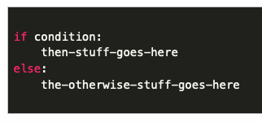
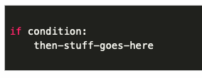
Branching the Code
If boolean:
T-statements
F-statements
Next Statements
In the beginning: goto lineNumber
If statements changed branching
Import things to know
Expression = Boolean
Indentation matters (scope)
print(“this is before if statement”)
if 0 < 1:
print(“execute true lines”)
else:
print(”or execute false lines”)
print(”this is after the branch”)
indent
indent
Gotchas
scope/indentation
:
nested if statements
indent
indent

Slide 13
Multiple Expressions
Dealing with multiple variables
(v e v) OR (v e v)
(v e v) AND (v e v)
True or False
== equality, not assignment
< less than
> greater than
<= less than and equal to
>= greater than and equal to
OR
AND
NOT

Slide 14
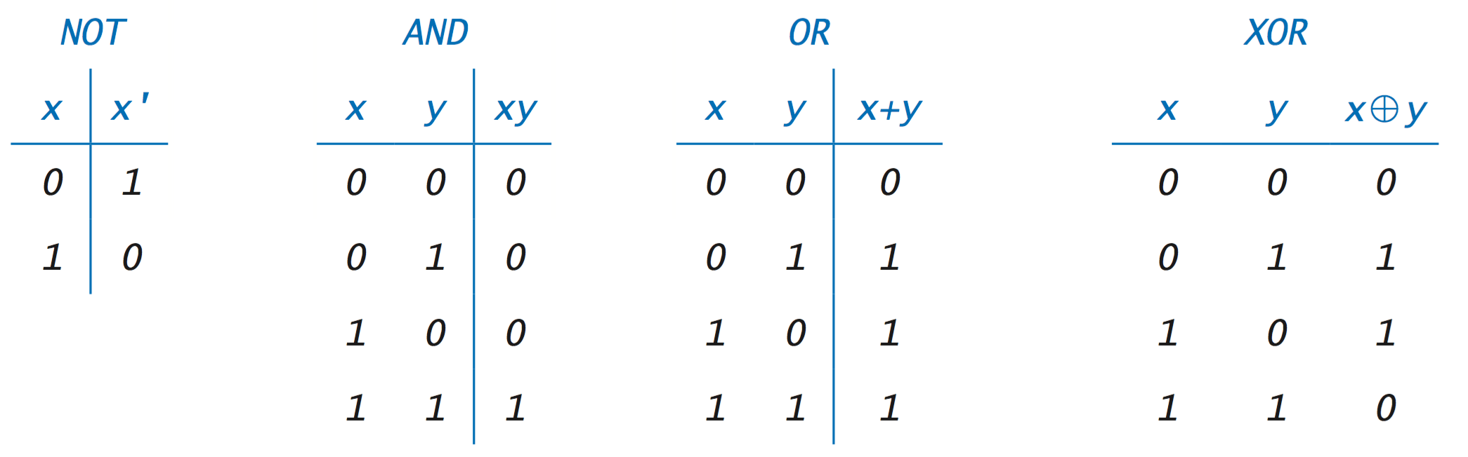
Multiple conditions
AND
OR
X AND Y
if either is false, then false,
else both are true, then true
X OR Y
if either are true, then true,
else both are false, then false
NOT
NOT TRUE = FALSE
NOT FALSE = TRUE
Gotchas
Order of Operation
if x == 5 or 6:
if first_name or last_name == "Scott":
To be or not to be – Shakespeare

Slide 15

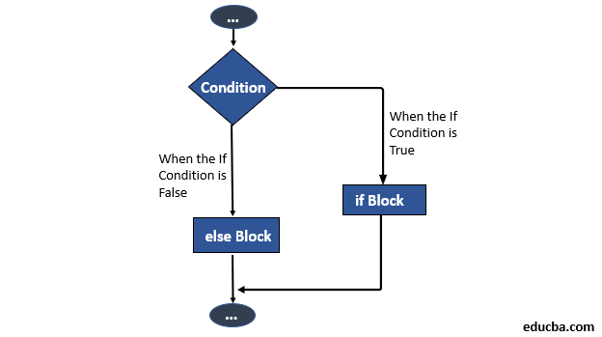
Prepare
Questions about
Conditional Statement
if <condition> : then_stuff_goes_here
else: then_stuff_goes_here
if <condition> : then_stuff_goes_here
elif <condition> : then_stuff_goes_here*
else: then_stuff_goes_here
Conditions
True or False equation
== equivalent, not assign (=)
Works for strings, but remember case
> greater than
< less than
in statement

Slide 16
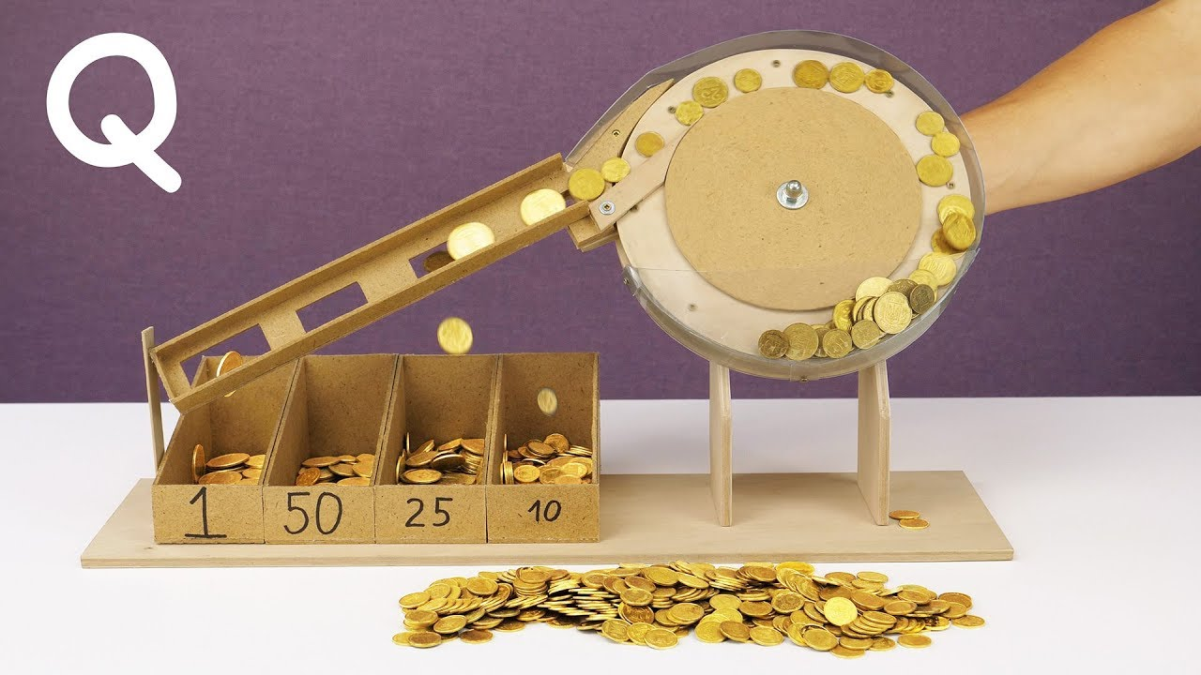
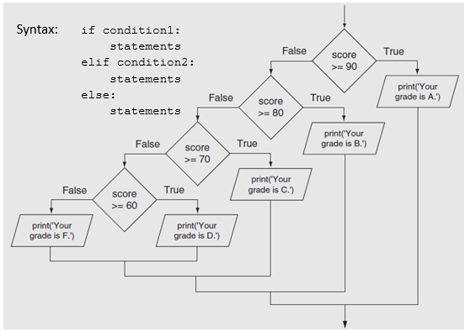
Differences
Multiple single ifs
Use of if, elif, else
coin = input(“Enter coin value”)
coin_value = int(coin)
new_value = 0; #default else
if coin == 25: new_value = .25
if coin == 10: new_value = .10
if coin == 5: new_value = .05
if coin == 1: new_value = .01
coin = input(“Enter coin value”)
coin_value = int(coin)
new_value = -1;
if coin == 25: new_value = .25
elif coin == 10: new_value = .10
elif coin == 5: new_value = .05
elif coin == 1: new_value = .01
else new_value = 0
Entered: 5

Slide 17
Differences
Multiple single ifs
Use of if, elif, else
coin = input(“Enter coin value”)
coin_value = int(coin)
new_value = -1;
if coin >= 25: new_value = .25
if coin >= 10: new_value = .10
if coin >= 5: new_value = .05
if coin >= 1: new_value = .01
coin = input(“Enter coin value”)
coin_value = int(coin)
new_value = -1;
if coin >= 25: new_value = .25
elif coin >= 10: new_value = .10
elif coin >= 5: new_value = .05
elif coin >= 1: new_value = .01
else new_value = 0
Entered: 5

Slide 18
Differences
Multiple single ifs
Use of if, elif, else
coin = input(“Enter coin value”)
coin_value = int(coin)
new_value = -1;
if coin >= 1: new_value = .01
if coin >= 5: new_value = .05
if coin >= 10: new_value = .10
if coin >= 25: new_value = .25
coin = input(“Enter coin value”)
coin_value = int(coin)
new_value = -1;
if coin >= 25: new_value = .25
elif coin >= 1: new_value = .01
elif coin >= 5: new_value = .05
elif coin >= 10: new_value = .10
else new_value = 0
Entered: 5

Slide 19
Differences
Multiple single ifs
Use of if, elif, else
Entered: 5
coin = input(“Enter coin value”)
coin_value = int(coin)
new_value = -1;
if coin >= 1: new_value = .01
if coin >= 5: new_value = .05
if coin >= 10: new_value = .10
if coin >= 25: new_value = .25
coin = input(“Enter coin value”)
coin_value = int(coin)
new_value = -1;
if 10 > coin and coin >= 25: new_value = .25
elif 0 > coin and coin >= 1: new_value = .01
elif 1 > coin and coin >= 5: new_value = .05
elif 5 > coin and coin >= 10: new_value = .10
else new_value = 0

Slide 20
Expressions
How do you know if you spouse is a programmer?
Send them shopping and tell them: "Get a loaf of bread and if they have eggs get 10." If they comes back with 10 loaves of bread
If statement only take the results of expressions, True or False
Use AND or OR to evaluate multiple expression in to on.
For Example
You are ask to get Milk AND Bread, if you don’t bring home both, then FALSE
You are asked to get White OR Brown bread, either will work. If you bring home cake then it is FALSE.

Slide 21

Checkpoint
What is the first number? 4
What is the second number? 3
The first number is greater
The numbers are not equal
The second number is not greater
What is your favorite animal? giraffe
That one is not my favorite..
Steps
Read instructions - Practicing If Statements
3 if/else statements
1
The first number is greater
The first number is not greater
2
The numbers are equal
The numbers are not equal
3
The second number is greater
The second number is not greater
Compare String
That's my favorite animal too!
That one is not my favorite.
Attempt coding the problem for 1 hour
Look at the Instructor code after 1 hour or when done.
Include in notes, what you learned from the instructor's code
What is the first number? 1009
What is the second number? 5250
The first number is not greater
The numbers are not equal
The second number is greater
What is your favorite animal? bear
That's my favorite animal too!
What is the first number? 42
What is the second number? 42
The first number is not greater
The numbers are equal
The second number is not greater
What is your favorite animal? BEAR
That's my favorite animal too!

Slide 22
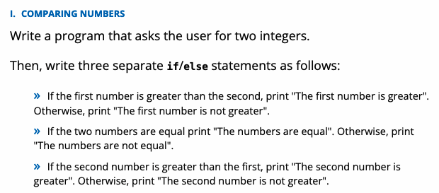
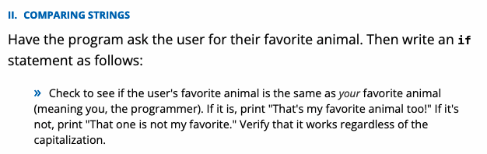
We solve people problems
Have I read the entire assignment?
What is the first number? 4
What is the second number? 3
The first number is greater
The numbers are not equal
The second number is not greater
What is your favorite animal? giraffe
That one is not my favorite..
What are the inputs?
How do inputs become outputs?
What are the outputs?
Input
Process
Output
What is the first number? 1009
What is the second number? 5250
The first number is not greater
The numbers are not equal
The second number is greater
What is your favorite animal? bear
That's my favorite animal too!
⌨️
💾
#Start here
print(“Hello World”)
#compile
# input
# process
# output
What is the first number? 42
What is the second number? 42
The first number is not greater
The numbers are equal
The second number is not greater
What is your favorite animal? BEAR
That's my favorite animal too!
#Start here
print(“Hello World”)
#compile
📺

Slide 23
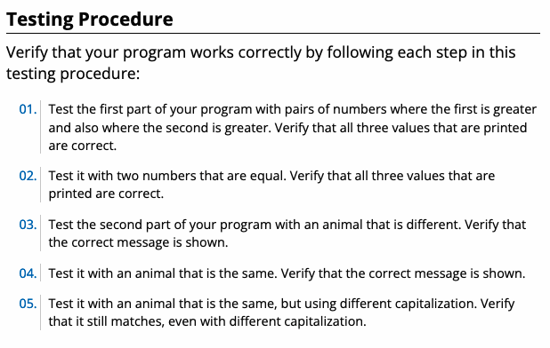
Testing … Is the product right? Is it the right product?
Part 1:
01. (A, B) -> A > B
02. (A, B) -> A = B
?? (A, B) -> A < B
Part 2:
03. Animal (Yours, Mine) -> !=
04. Animal (Yours, Mine) -> ==
05. Animal (Yours, Mine) -> case

Slide 24

Teach: Team Activity
Meet and setup a video call, share screen
Overview
Grade Calculator
A >= 90
B >= 80
C >= 70
D >= 60
F < 60
Use if-elif-else
Core requirements
Must have the core requirements
Ask user
Determine Letter grade, indicate if passed the class
Use variables and only 1 print
Stretch Challenge
Add +/- to score, single print, see hint
Account for No A+
Account for No F+ or F-
Teacher Solution
Submission
In notes tell me what you learned from the teacher solutions.

Slide 25
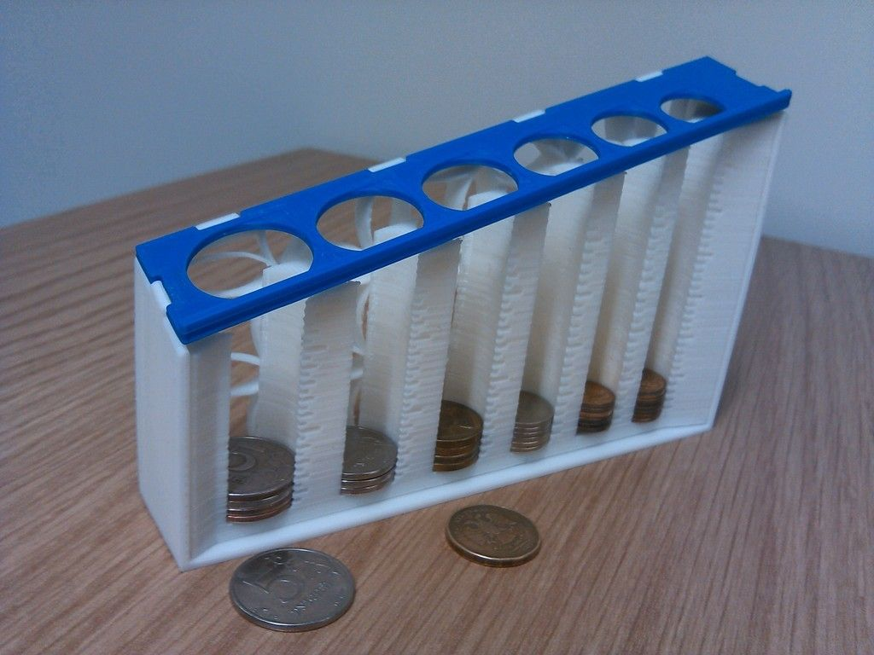
Grade Calculator
A >= 90
B >= 80
C >= 70
D >= 60
F < 60
Use if-elif-else
Remember
Ask user
Determine Letter grade, indicate if passed the class
Use variables and only 1 print
90
A
Main Goal
80
B
70
C
F
60
D
Stretch
D-
F+
D-
D+
C-
C+
B-
B+
A-
A+

Slide 26
Prove
Remember: We're Going on a Bear Hunt!
Overview
In a text-based adventure game, the user is presented a scenario with different options. Depending on the option they choose, they have different consequences, which in turn present different choices for the next action
Program the following:
Have three levels of scenarios with possible choices. Comment Scenarios
At least one of your scenarios must have more than two possible choices.
In each prompt, write the choices in ALL CAPS,
When checking the user's responses, you should match on the keyword
Making different choices should take you to different scenarios
Choices should only work for the correct question.
In other words, if one scenario resulted in choices of Run/Hide, but another resulted in choices Follow/Look, you should not be able to respond with "Follow" to the question that asked for Run/Hide.
A good way to accomplish this is to have a series of nested if statements. (That is, the print and then the next if statement will be within the body/block of the first if statement.)
For each question, you should provide an "else" clause to handle the case that the user tries to type something other than the possible choices. It is up to you how to handle this case.
Make it your own
Submission
Upload program (the .py file) to the assignment
Submission Comment: What you think you did and 1-2 sentences justify your that describes your effort
1 = Some attempt made, 2 = Developing (but significantly deficient), 3 = Slightly deficient, 4 = Meets requirements, 5 = Made it your own
You are walking through a dark forest and find two items: a MATCH and a FLASHLIGHT. Which one do you want to pick up?
match
You pick up the match and strike it, and for an instant, the forest around you is illuminated. You see a large grizzly bear, and then the match burns out. Do you want to RUN, or HIDE behind a tree?
flasHliGht
You pick up the flashlight and turn it on. You see the pathway lit up in front of you, but you thought you also heard something off to the side. Do you want to FOLLOW the path or LOOK in the trees for the thing that made the noise?

Slide 27
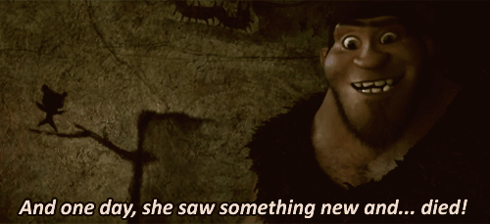
We solve people problems
Have I read the entire assignment?
What are the inputs?
How do inputs become outputs?
What are the outputs?
Input
Process
Output
Program the following:
Have three levels of scenarios with possible choices. Comment Scenarios
At least one of your scenarios must have more than two possible choices.
In each prompt, write the choices in ALL CAPS,
When checking the user's responses, you should match on the keyword
Making different choices should take you to different scenarios
Choices should only work for the correct question.
In other words, if one scenario resulted in choices of Run/Hide, but another resulted in choices Follow/Look, you should not be able to respond with "Follow" to the question that asked for Run/Hide.
A good way to accomplish this is to have a series of nested if statements. (That is, the print and then the next if statement will be within the body/block of the first if statement.)
For each question, you should provide an "else" clause to handle the case that the user tries to type something other than the possible choices. It is up to you how to handle this case.
⌨️
💾
#Start here
print(“Hello World”)
#compile
# input
# process
# output
#Start here
print(“Hello World”)
#compile
Use if, elif, else, not just if/else
📺

Slide 28

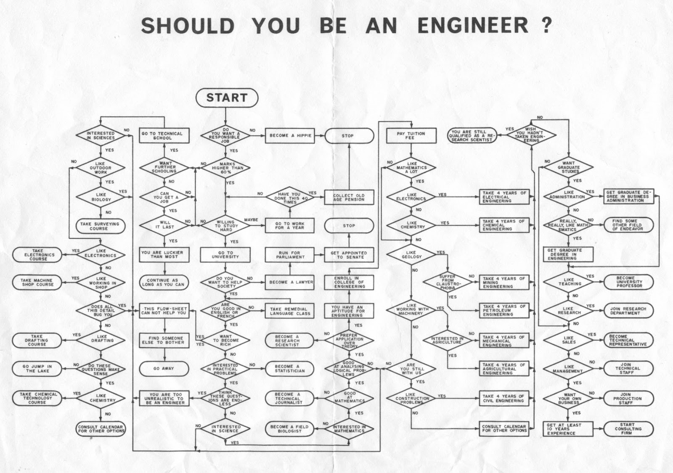
Real Examples

Slide 29
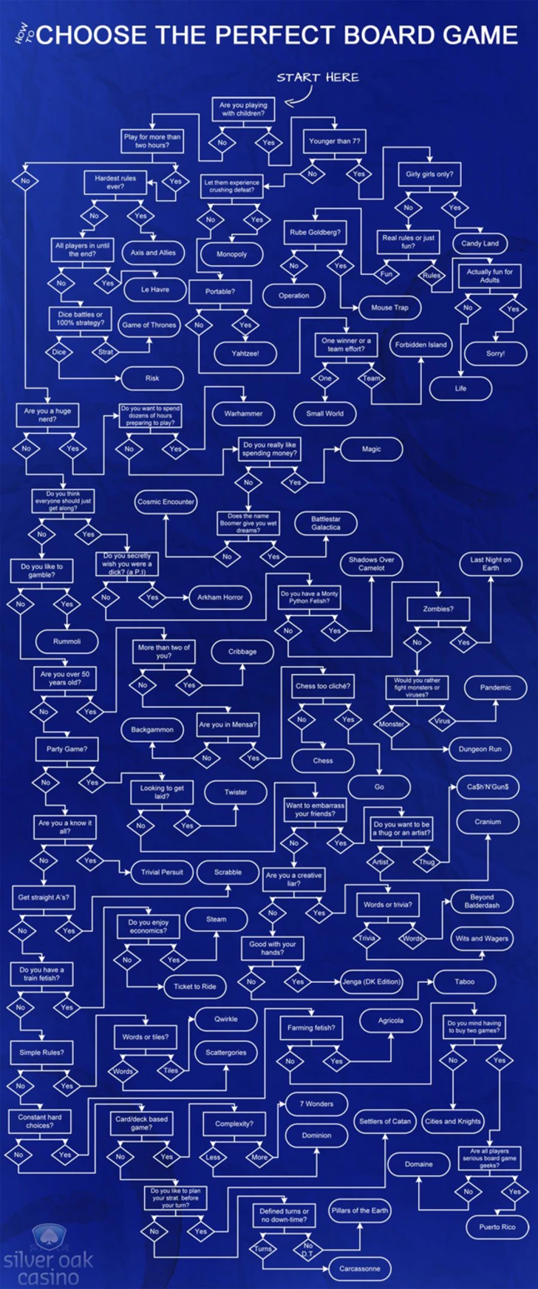
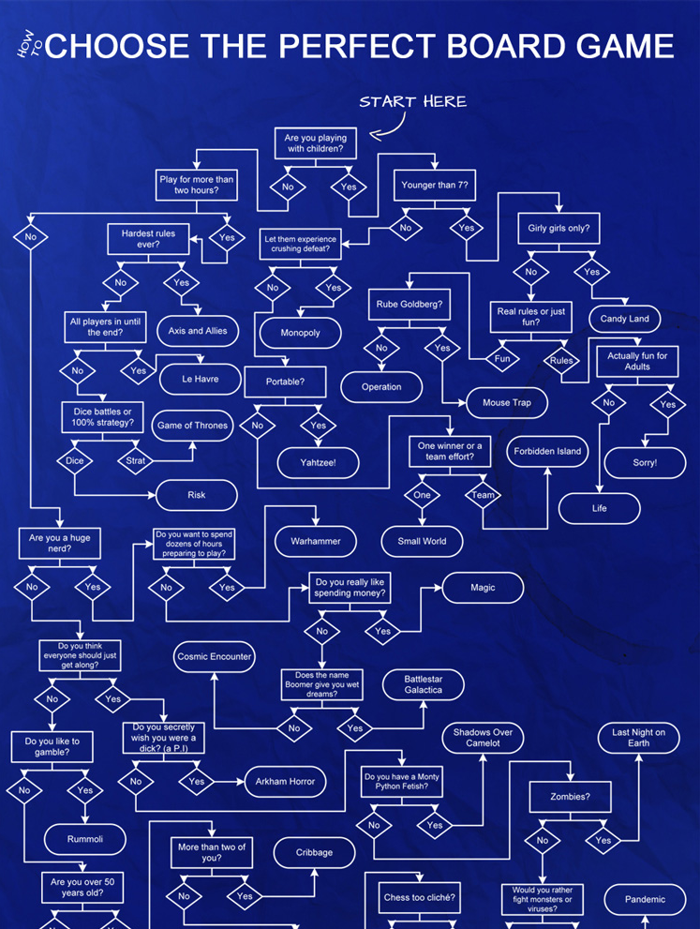
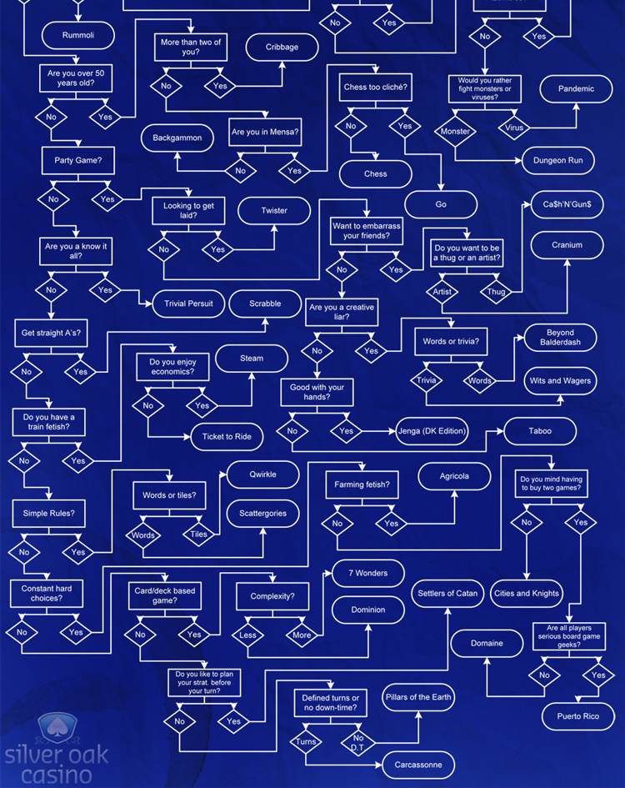

Slide 30
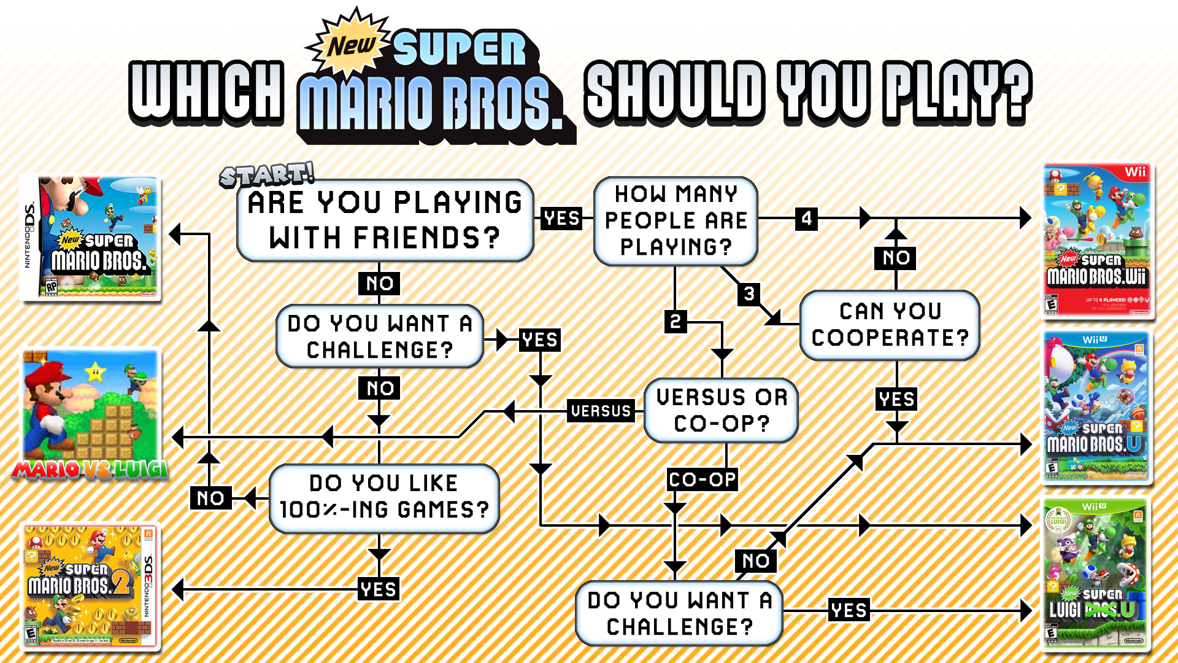
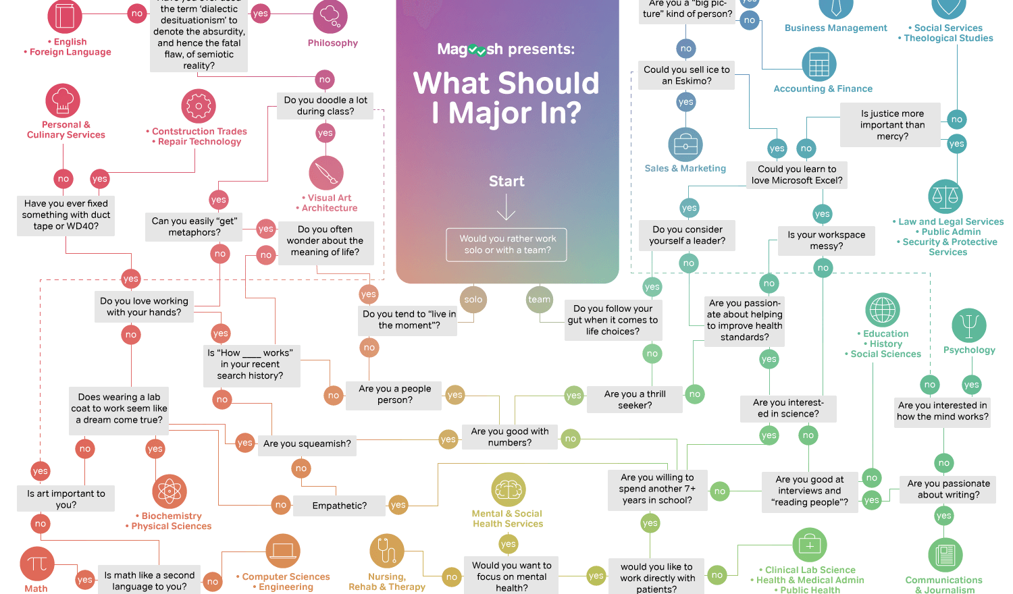
Notes:
http://www.cs.put.poznan.pl/amichalski/PWSZ/systemy/propozycje/

Slide 31

You are walking through a dark forest and find two items: a MATCH and a FLASHLIGHT. Which one do you want to pick up?
Create your own text-based adventure game with at least three levels of choices. It's up to you to determine the scenarios, the choices, and the consequences.
LVL 1
Match?
You pick up the match and strike it, and for an instant, the forest around you is illuminated. You see a large grizzly bear, and then the match burns out. Do you want to RUN, or HIDE behind a tree?
You pick up the flashlight and turn it on. You see the pathway lit up in front of you, but you thought you also heard something off to the side. Do you want to FOLLOW the path or LOOK in the trees for the thing that made the noise?
Run?
Follow?
LVL 2
What happens when you run.
Followed by choice?
What happens when you hide. Followed by choice?
At least one of your scenarios must have more than two possible choices.
What happens when you follow.
Followed by choice?
What happens when you look.
Followed by choice?
Choice?
Choice?
Choice?
Choice?
LVL 3
Choice?
Choice?
Final Results
Final Results
Final Results
Final Results
Final Results
Final Results
Final Results
Final Results

Slide 32
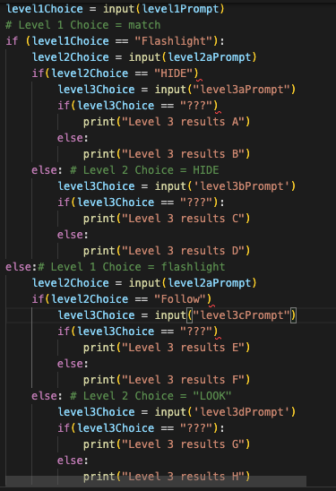
What is missing?
What is wrong?

